Slide 1

統計學習與深度學習
期末報告
組名 : Tequila Sunrise
組員 : 陳品妤、許哲榮、卓彥廷、歐崇愷

Slide 2
目錄
1
問題描述
2
資料處理
3
預測方法
4
預測結果 --- Imbalanced data
5
預測結果 --- Under-sampling data
6
預測結果 --- Over-sampling data

Slide 3
問題描述
主題：Credit Card Fraud Detection
將貸款人的個人資料作為特徵值，預測未來是否會違約

Slide 4
目錄
1
問題描述
2
資料處理
3
預測方法
4
預測結果 --- Imbalanced data
5
預測結果 --- Under-sampling data
6
預測結果 --- Over-sampling data

Slide 5
資料描述
原始資料: 307511 rows × 122 columns
刪除資料筆數小於兩萬的 column -> 刪除49columns
刪除資料缺失達到 1/3 的 row -> 沒有刪除
將 categorical data 轉為 one hot coding -> 191columns
刪除發生次數小於 10 的 column -> 178columns
運用 sklearn 的 knnImputer 補齊缺失的資料

Slide 6
資料處理
將資料分為 categorical data & interval data
將 interval data 取 PCA
n_conponents = min(n_sample, n_feature)

Slide 7
資料處理
處理 Data Imbalance 的問題
資料不平衡 → Minimize Loss Function 表現不佳
處理方法：
Under-Sampling
Subtraining set: 33513, validation set: 11172, testing set: 4965
Over-Sampling
Subtraining set: 457950, validation set: 27677, testing set: 30752

Slide 8
資料處理
處理 Data Imbalance 的問題 --- Oversampling
將 target = 0 和 target = 1 的資料分開
各自切 subtraining (67.5%), validation (22.5%), testing set (10%)
將 target = 1 的 subtraining, over sampling

Slide 9
目錄
1
問題描述
2
資料處理
3
預測方法
4
預測結果 --- Imbalanced data
5
預測結果 --- Under-sampling data
6
預測結果 --- Over-sampling data

Slide 10

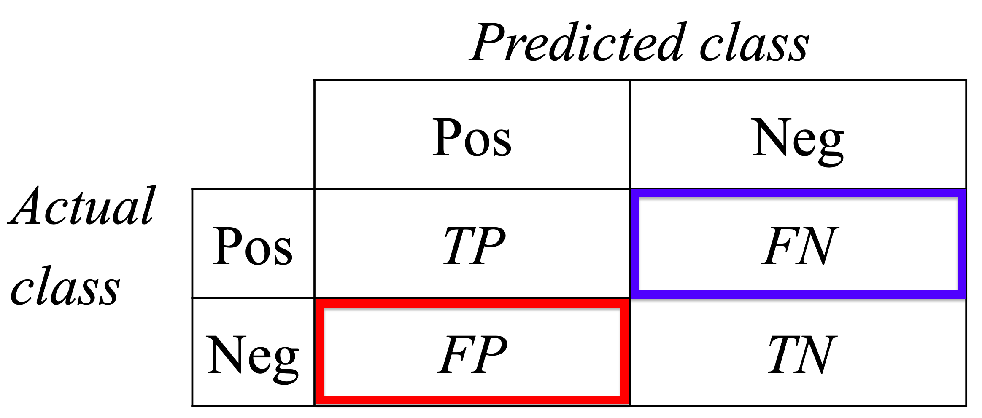
預測方法
Logistic Regression
Decision Tree
Random Forest
DNN
Gradient Boosting
XGBoost
LightGBM
使用自行定義的 opt_score 來評估模型的預測結果
Opt_score1 = Specificity*pro_0*3% - (1 – recall)*pro_1*100%
Opt_score2 =
KEY WORDS
KEY WORDS
KEY WORDS
KEY WORDS
KEY WORDS
KEY WORDS
KEY WORDS

Slide 11
XGBoost
平行處理：
雖然整個運行過程是串行的，但每層（level wise）選取分類點時是可以平行處理的。程式會預先排序可能的分裂點，然後選取其中比較好的進行平行生長，缺點還是會算到許多不夠好的點浪費時間和空間。
預防overfitting：
除了內建的L1 和L2 regularization 之外，還有許多方法例如：columns subsampling 、設置決策樹的max_depth 來預防overfitting.
可以調整樣本權重（scale_pos_weight）：
如此以來便可以補償那些樣本較少的類別

Slide 12
LightGBM
Gradient-based One-Side Sampling (GOSS) :
Drop instances with little contribution to information gain. This(down sampling) will lead to more accurate gain estimation than uniformly random sampling.
在取樣時，隨機捨棄掉對損失函數貢獻較小（小於閾值）的點再做取樣，這樣比全部隨機取樣的估計值來得好。
Exclusive Feature Bundling (EFB) :
Reduce the number of effective features. Developers design an algorithm to safely pack those almost mutually exclusive feature in sparse feature space(e.g.many one-hot features) => Significant speed up in large-scaled data according to the experiments.
在稀疏（很多值為0）的特徵空間中，使用一種演算法去安全地合併一些（幾乎）互斥的特徵。在處理大型資料即時，可以使得運算過程大幅加快。
leaf-wise growing： <=>XGBoost level-wisegrowing
每次都是從當前所有葉子節點中去找分裂能帶來最多效益的節點去分枝，比較大的機率會長出較深的決策樹。

Slide 13
目錄
1
問題描述
2
資料處理
3
預測方法
4
預測結果 --- Imbalanced data
5
預測結果 --- Under-sampling data
6
預測結果 --- Over-sampling data

Slide 14
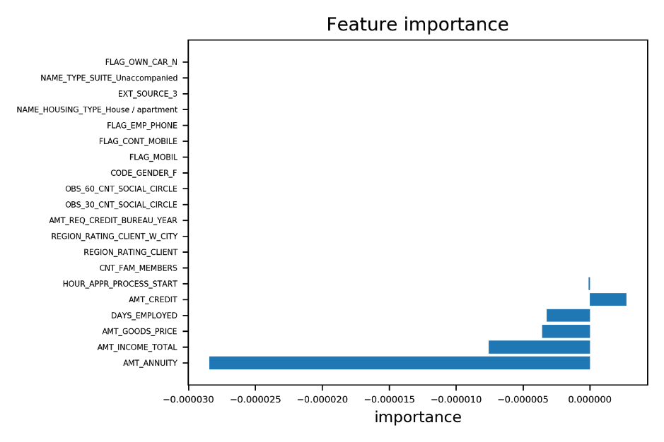
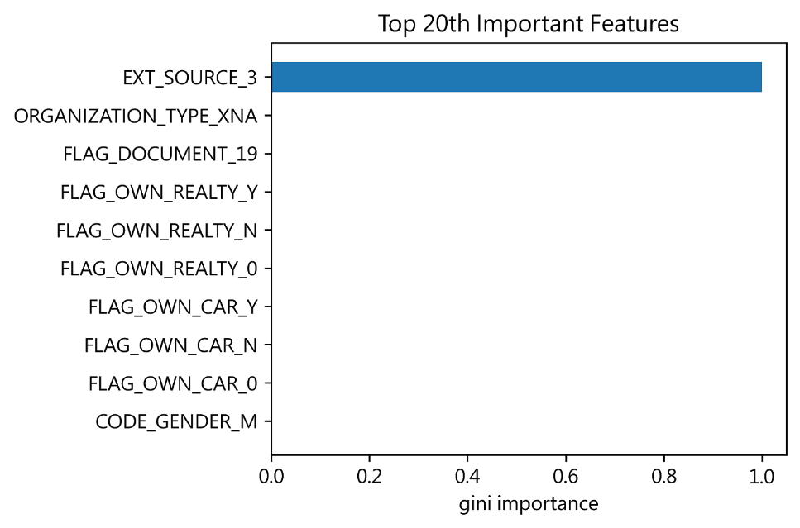
Feature Importance --- opt_score1
Logistic Regression
Decision Tree

Slide 15
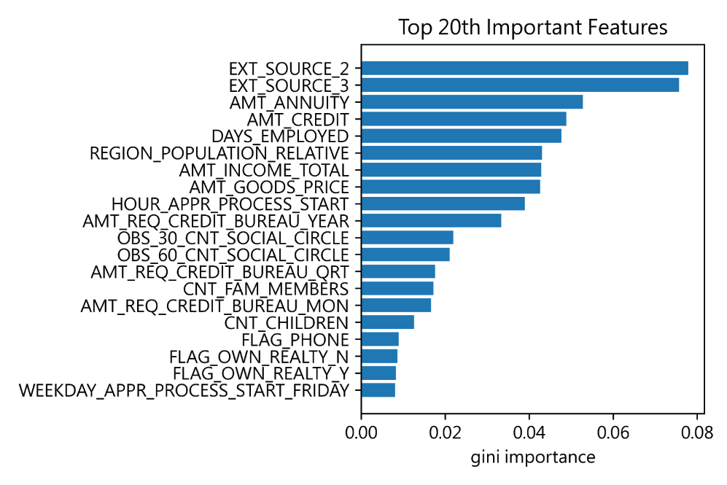
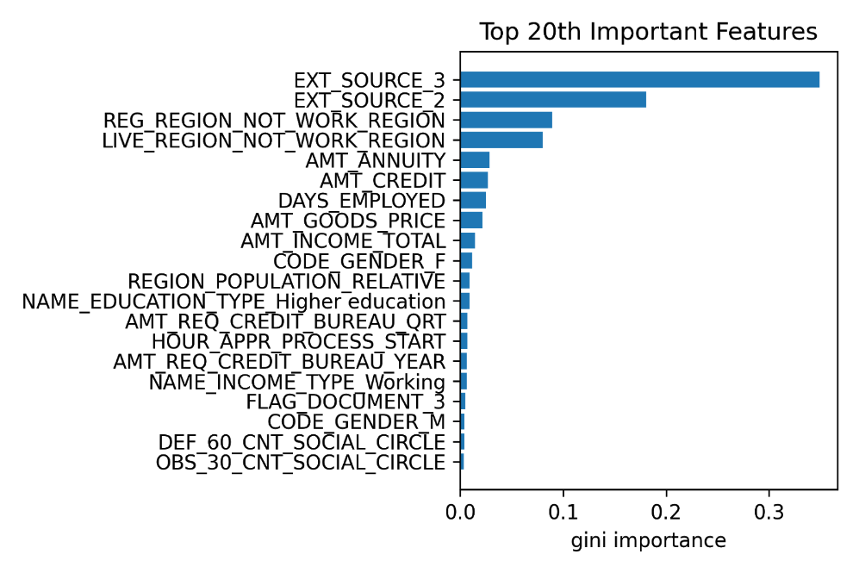
Feature Importance --- opt_score1
Random Forest
Gradient Boosting

Slide 16
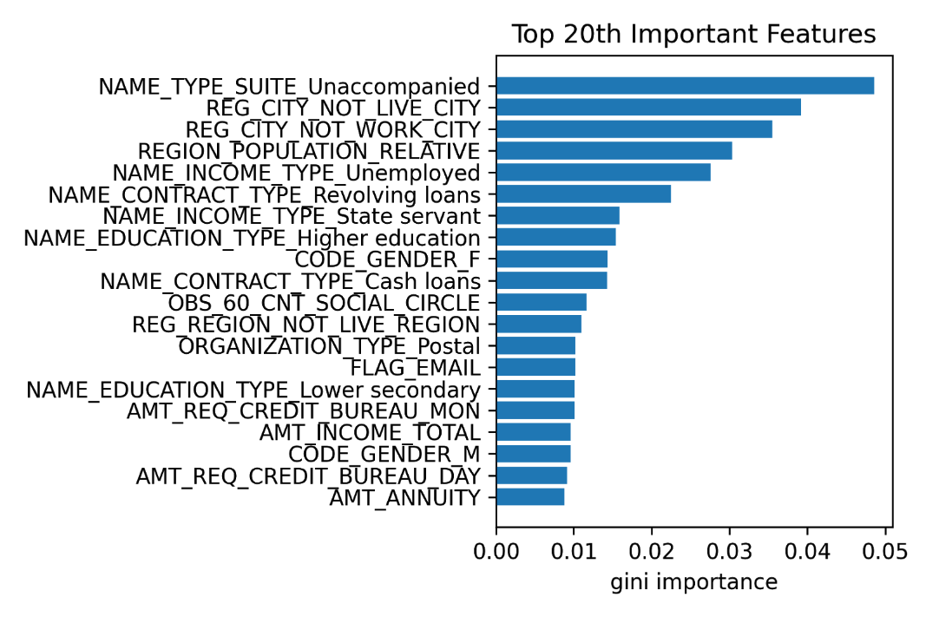
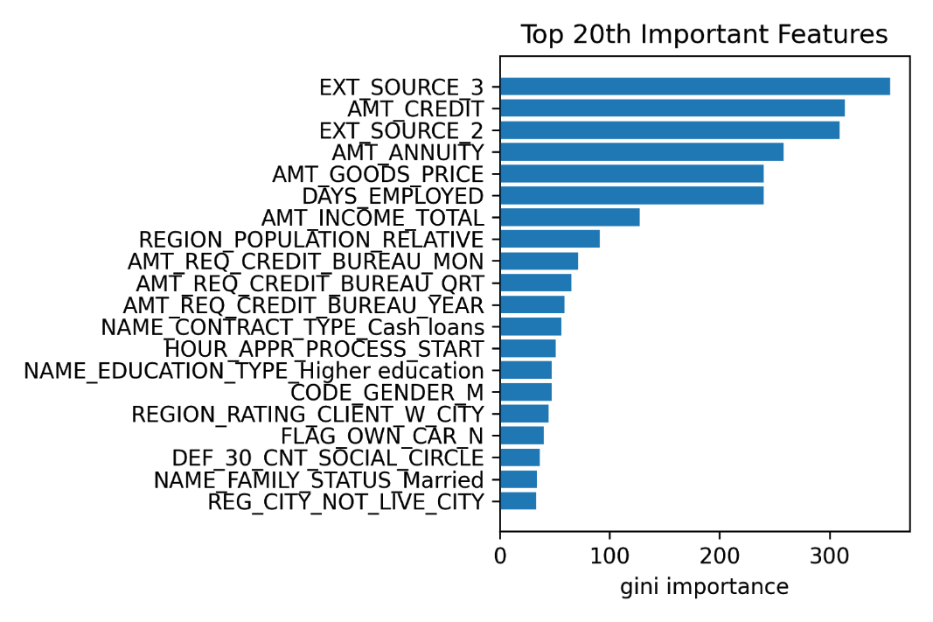
Feature Importance --- opt_score1
XGBoost
LightGBM

Slide 17
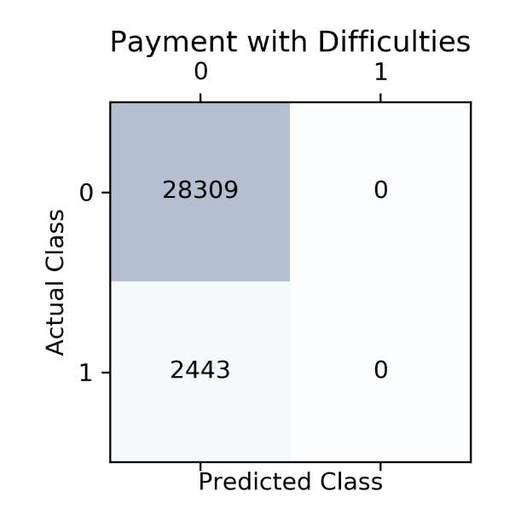
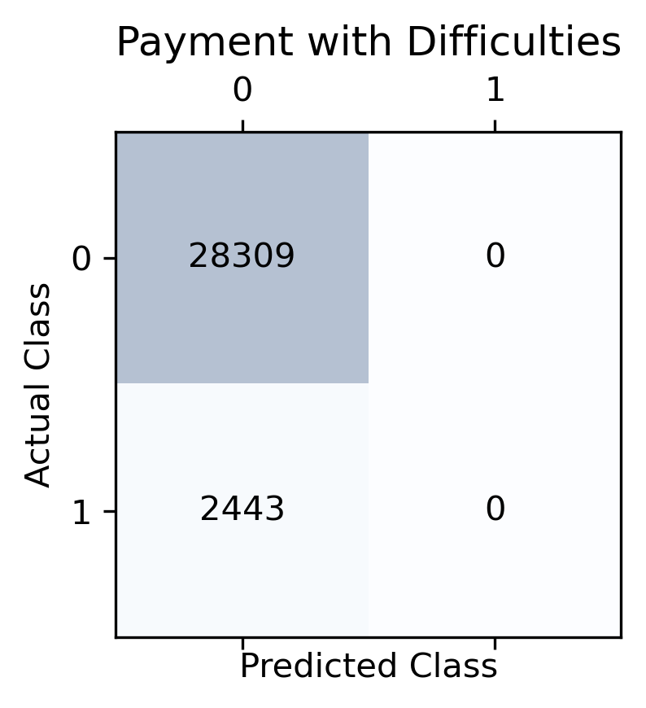
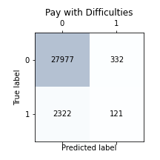
Confusion Matrix --- opt_score1
Logistic Regression
Decision Tree
Random Forest

Slide 18
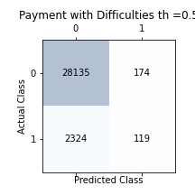
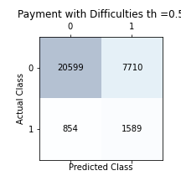
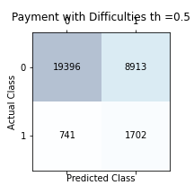
Confusion Matrix --- opt_score1
Gradient Boosting
XGBoost
LightGBM

Slide 19
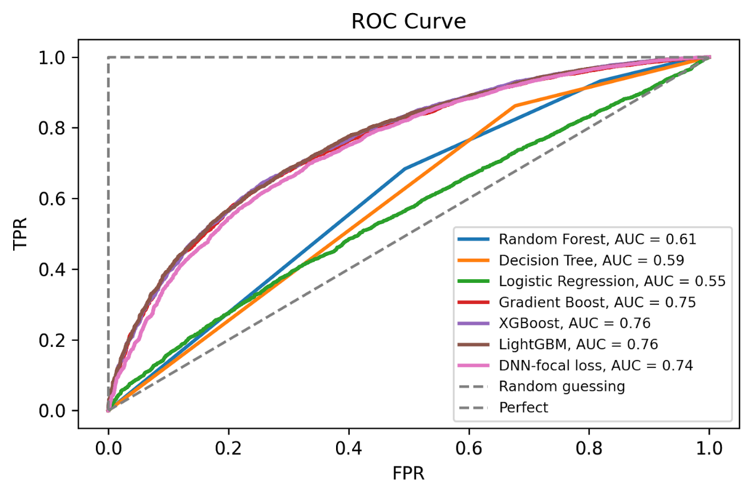
ROC Curve --- opt_score1

Slide 20
比較表格
 | AUC | Accuracy | F1 socre | Recall | Precision | Specificity | Opt score1
Decision Tree | 0.59 | 0.92 | 0 | 0 | 0 | 1 | 0.23
Random Forest | 0.59 | 0.91 | 0.08 | 0.04 | 0.26 | 0.99 | 0.25
Logistic Regression | 0.60 | 0.92 | 0 | 0 | 0 | 1 | 0.23
DNN-MFSE |  | 0.69 | 0.26 | 0.67 | 0.16 | 0.69 | 0.43
Gradient Boosting | 0.75 | 0.92 | 0.08 | 0.05 | 0.40 | 0.99 | 0.25
XGBoost | 0.76 | 0.72 | 0.27 | 0.65 | 0.17 | 0.72 | 0.46
LightGBM | 0.76 | 0.69 | 0.26 | 0.70 | 0.16 | 0.69 | 0.47

Slide 21
比較表格
 | AUC | Accuracy | F1 socre | Recall | Precision | Specificity | Opt score2
Decision Tree | 0.59 | 0.92 | 0 | 0 | 0 | 1 | -19237
Random Forest | 0.59 | 0.91 | 0.08 | 0.04 | 0.26 | 0.99 | -18008
Logistic Regression | 0.55 | 0.92 | 0 | 0 | 0 | 1 | -19238
XGBoost | 0.76 | 0.72 | 0.27 | 0.65 | 0.17 | 0.72 | 1167
LightGBM | 0.76 | 0.69 | 0.26 | 0.70 | 0.16 | 0.69 | 2316

Slide 22
Deep Feedforward Neural Network
Input Layer
Hidden Layer
Output Layer
Linear + Relu
177 → H → H → ... → H → 2

Slide 23
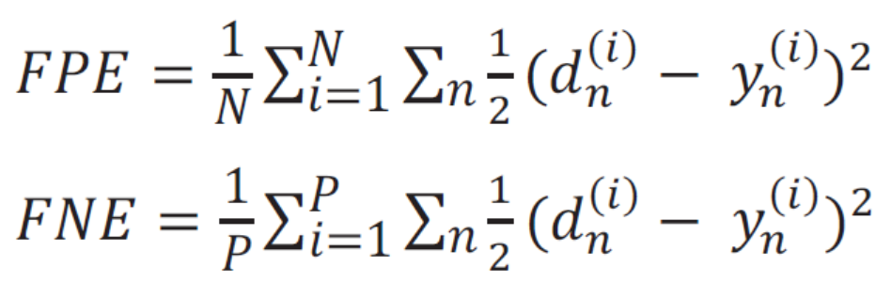
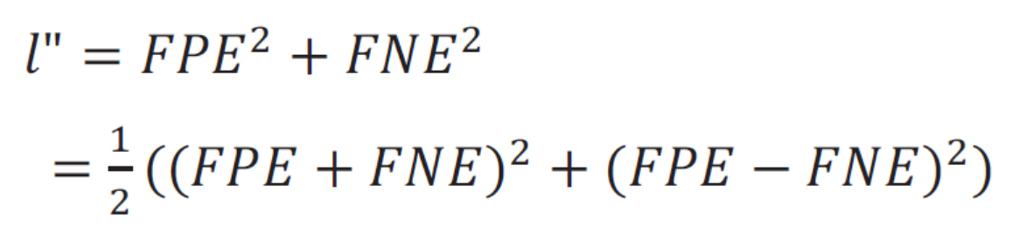
Loss Function 1: Mean False Error (MFE)

Slide 24
Deep Feedforward Neural Network - MSFE
Learning Rate:
0.000001 ~ 0.1 (四個)
Number of Nodes
177, 354, 531, 708 (四個)
Number of Hidden Layers:
1, 2, 3, 4 (四個)

Slide 25
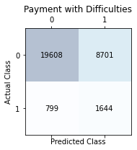
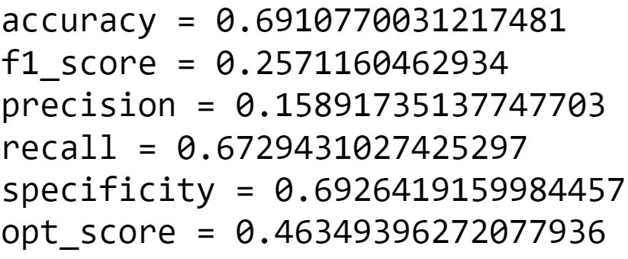
Deep Feedforward Neural Network - MSFE

Slide 26
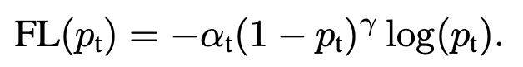
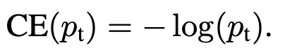
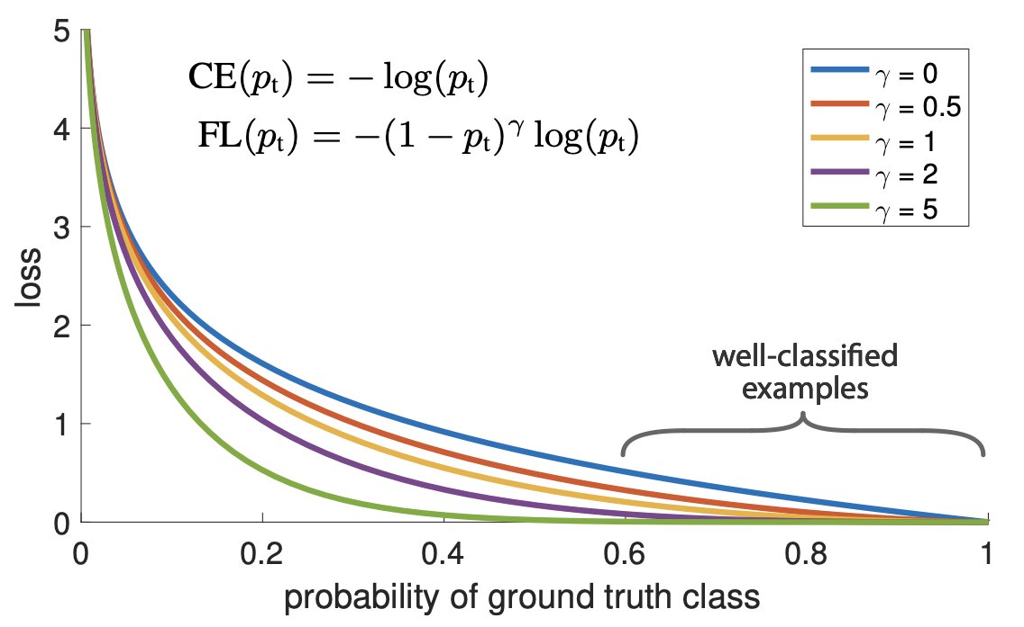
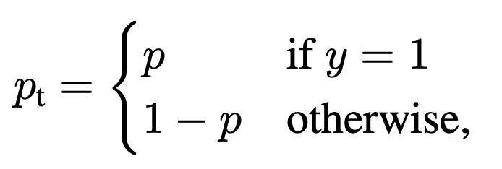
Loss Function 2: Focal Loss
- an improved BCELoss
v.s

Slide 27
目錄
1
問題描述
2
資料處理
3
預測方法
4
預測結果 --- Imbalanced data
5
預測結果 --- Under-sampling data
6
預測結果 --- Over-sampling data

Slide 28
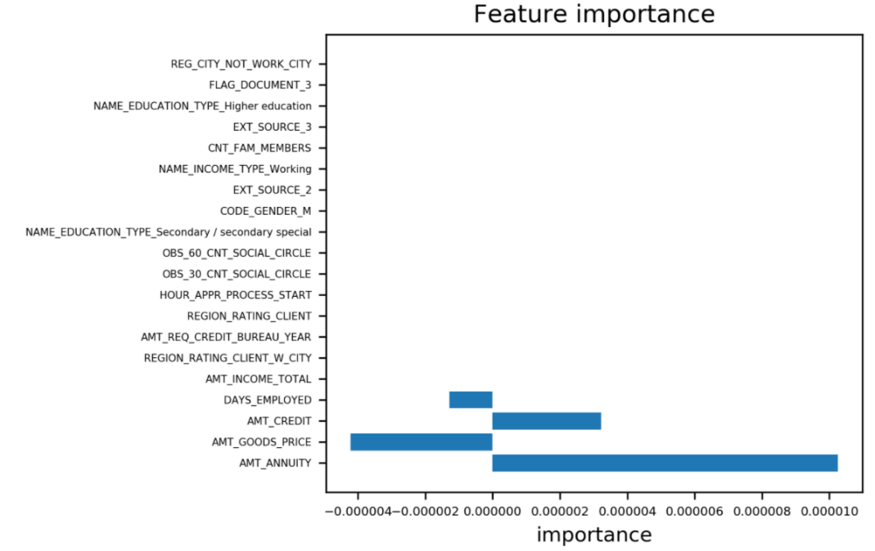
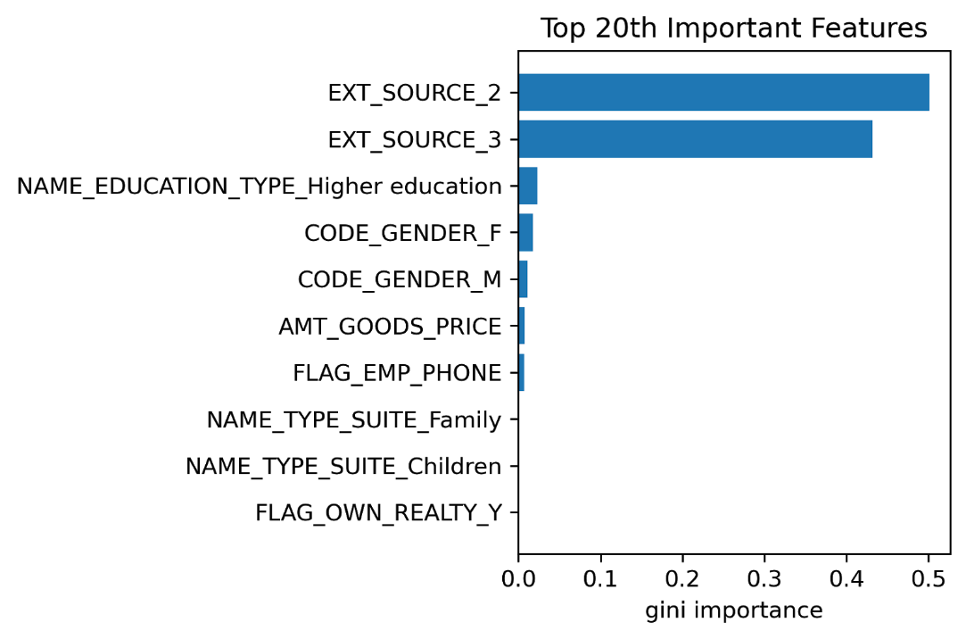
Feature Importance --- opt_score1
Logistic Regression
Decision Tree

Slide 29
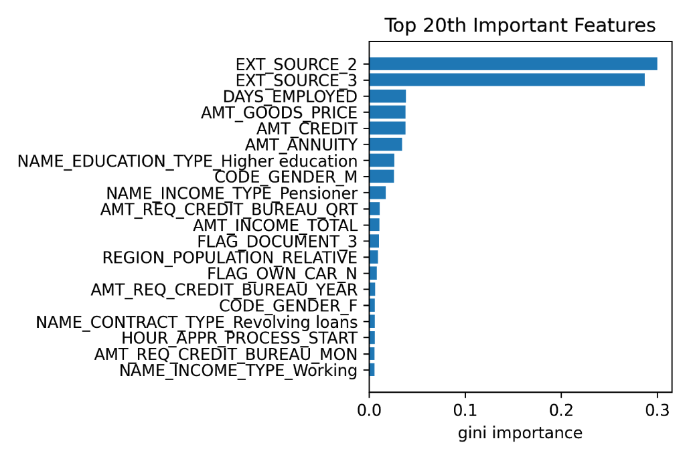
Feature Importance --- opt_score1
Gradient Boosting

Slide 30
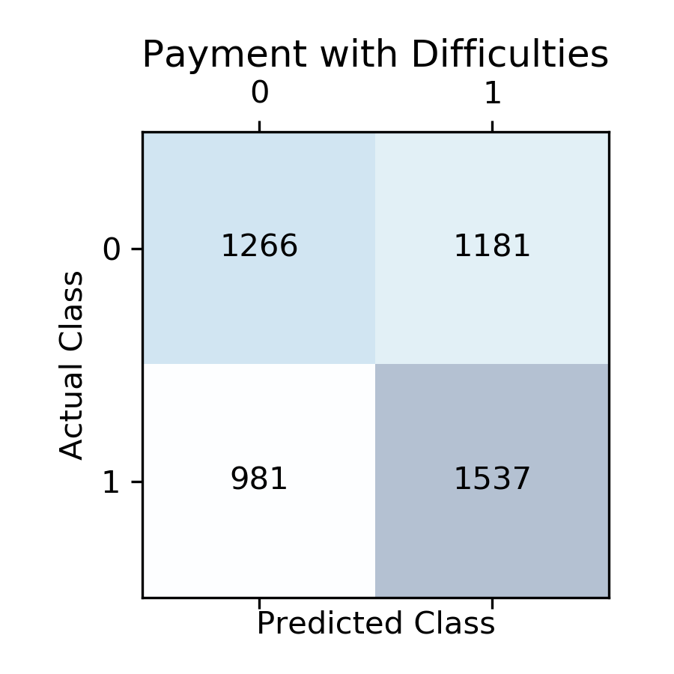
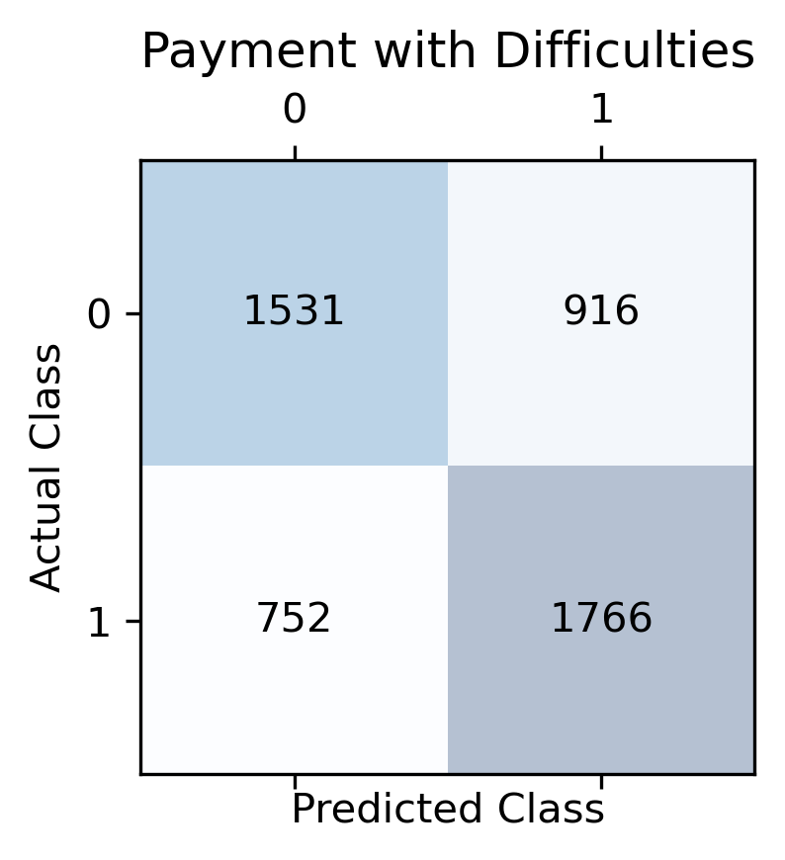
Confusion Matrix --- opt_score1
Logistic Regression
Decision Tree
Gradient Boosting

Slide 31
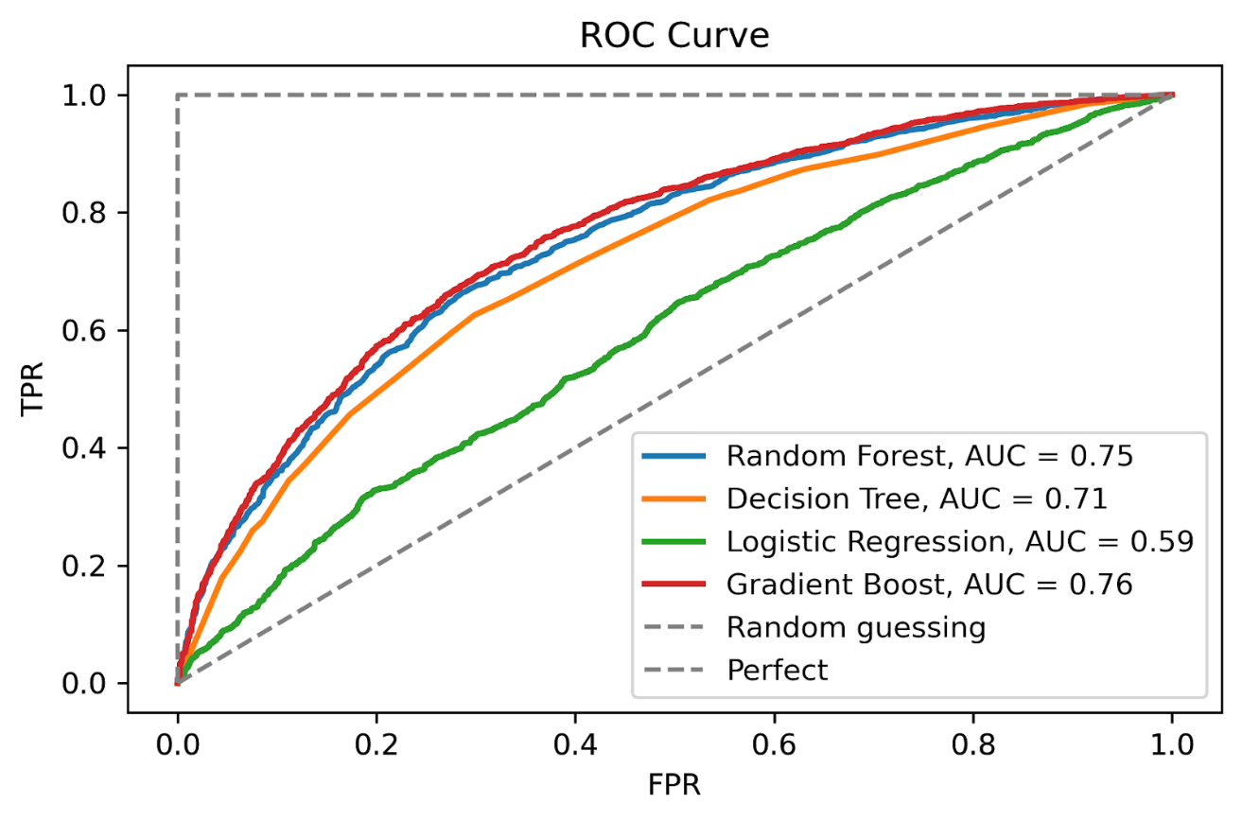
ROC Curve --- opt_score1

Slide 32
比較表格
 | AUC | Accuracy | F1 socre | Recall | Precision | Specificity | Opt score1
Decision Tree | 0.71 | 0.66 | 0.68 | 70 | 0.66 | 0.62 | 0.47
Random Forest | 0.75 | 0.68 | 0.69 | 0.69 | 0.69 | 0.68 | 0.47
Logistic Regression | 0.59 | 0.56 | 0.59 | 0.61 | 0.57 | 0.52 | 0.41
Gradient Boosting | 0.76 | 0.69 | 0.70 | 0.69 | 0.70 | 0.69 | 0.47

Slide 33
比較表格
 | AUC | Accuracy | F1 socre | Recall | Precision | Specificity | Opt score2
Decision Tree | 0.71 | 0.66 | 0.68 | 70 | 0.66 | 0.62 | -86795
Random Forest | 0.75 | 0.68 | 0.68 | 0.68 | 0.68 | 0.68 | -97905
Logistic Regression | 0.59 | 0.56 | 0.59 | 0.61 | 0.57 | 0.52 | -115399
Gradient Boosting | 0.76 | 0.69 | 0.70 | 0.69 | 0.70 | 0.69 | -92029

Slide 34
目錄
1
問題描述
2
資料處理
3
預測方法
4
預測結果 --- Imbalanced data
5
預測結果 --- Under-sampling data
6
預測結果 --- Over-sampling data

Slide 35
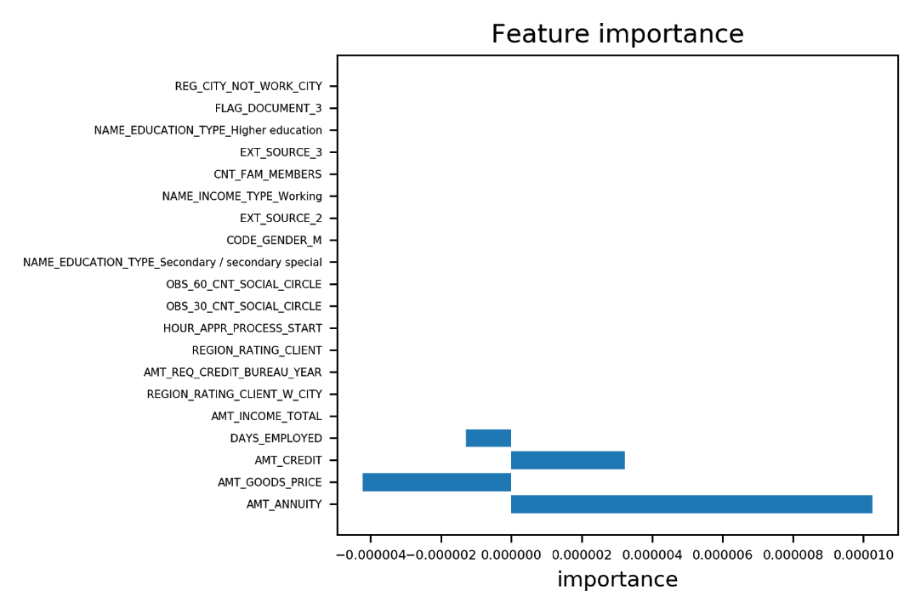
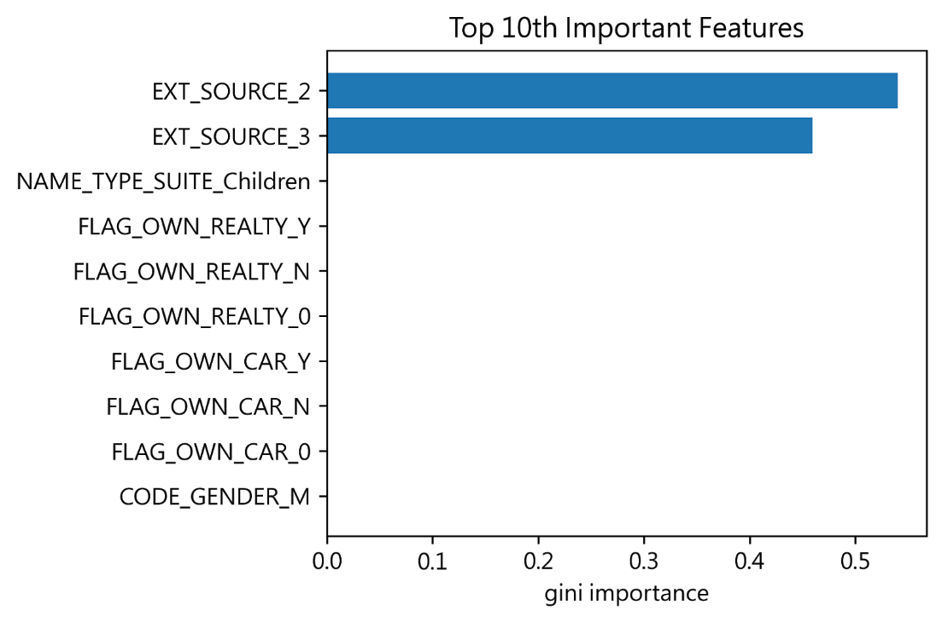
Feature Importance --- opt_score1
Logistic Regression
Decision Tree

Slide 36
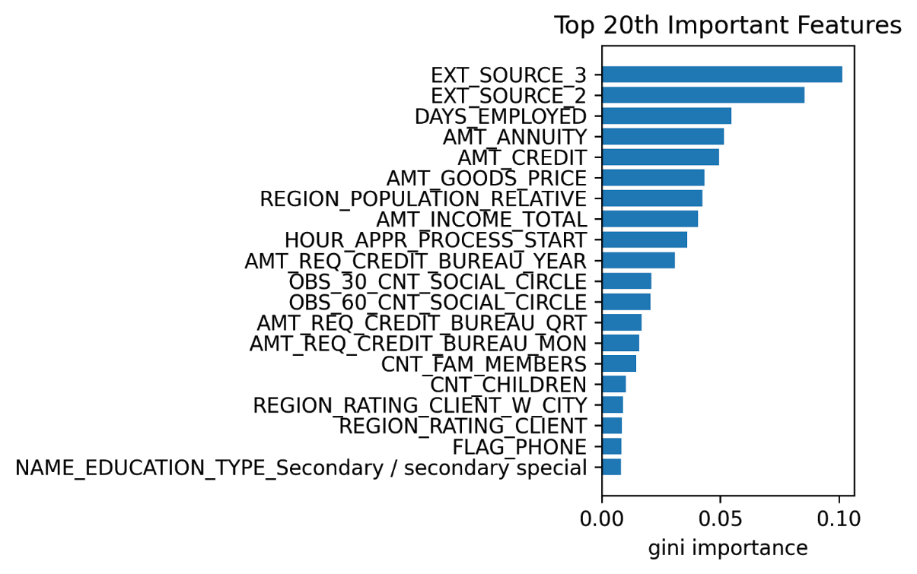
Feature Importance --- opt_score1
Random Forest

Slide 37
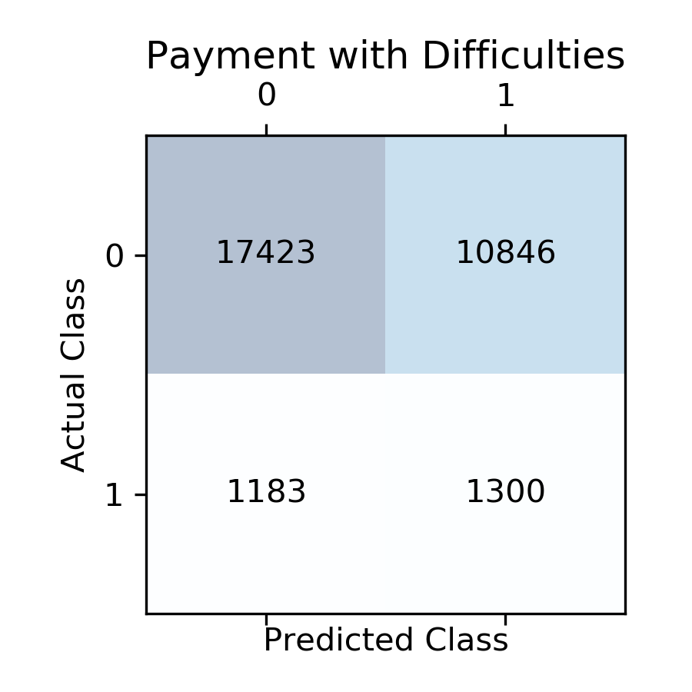
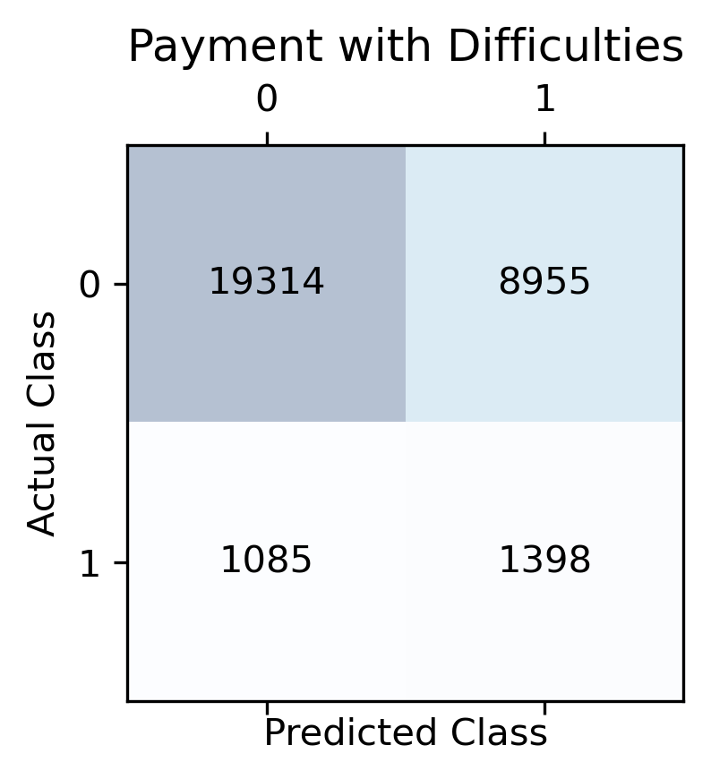
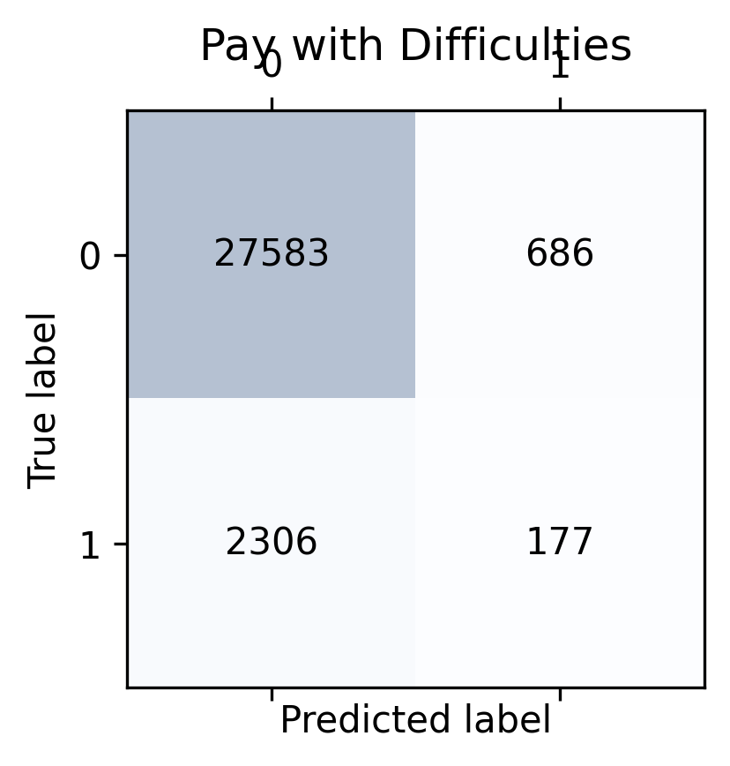
Confusion Matrix --- opt_score1
Logistic Regression
Decision Tree
Random Forest

Slide 38
比較表格
 | AUC | Accuracy | F1 socre | Recall | Precision | Specificity | Opt score1
Decision Tree | 0.66 | 0.67 | 0.22 | 0.56 | 0.14 | 0.68 | 0.42
Random Forest | 0.61 | 0.90 | 0.11 | 0.08 | 0.22 | 0.98 | 0.26
Logistic Regression | 0.60 | 0.61 | 0.18 | 0.52 | 0.11 | 0.62 | 0.39

Slide 39
比較表格
 | AUC | Accuracy | F1 socre | Recall | Precision | Specificity | Opt score2
Decision Tree | 0.66 | 0.67 | 0.22 | 0.56 | 0.14 | 0.68 | -3829
Random Forest | 0.61 | 0.90 | 0.11 | 0.08 | 0.22 | 0.98 | -16973
Logistic Regression | 0.60 | 0.61 | 0.18 | 0.52 | 0.11 | 0.62 | -8288

Slide 40
THANK YOU
PLEASE ADD YOUR COMPANY NAME OR NAME HERE

Slide 41
附錄

Slide 42

Logistic Regression --- opt_score2
Feature Importance

Slide 43

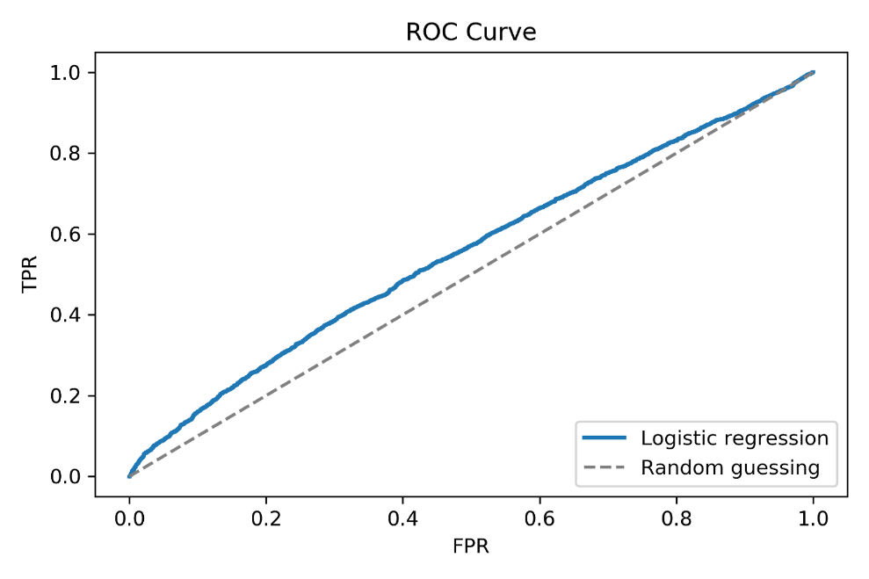
Logistic Regression --- opt_score2
Confusion Matrix
ROC Curve

Slide 44
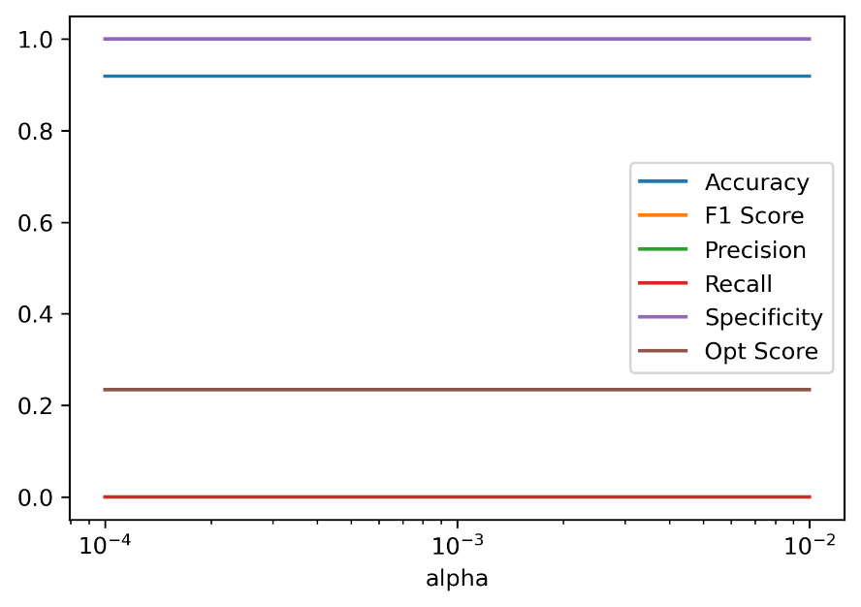
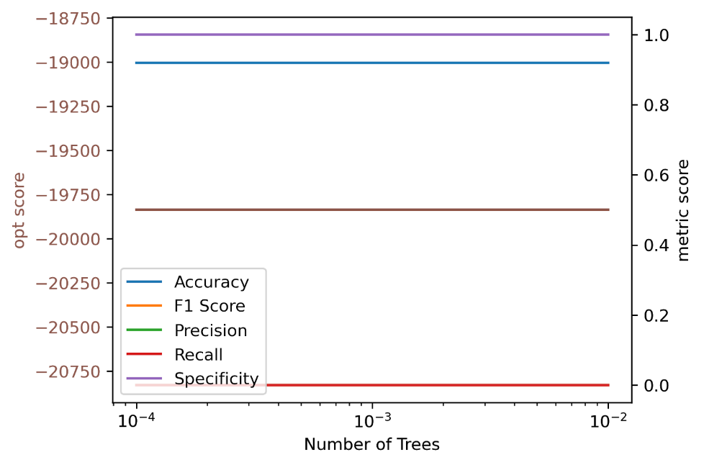
Decision Tree
opt_score1
opt_score2

Slide 45
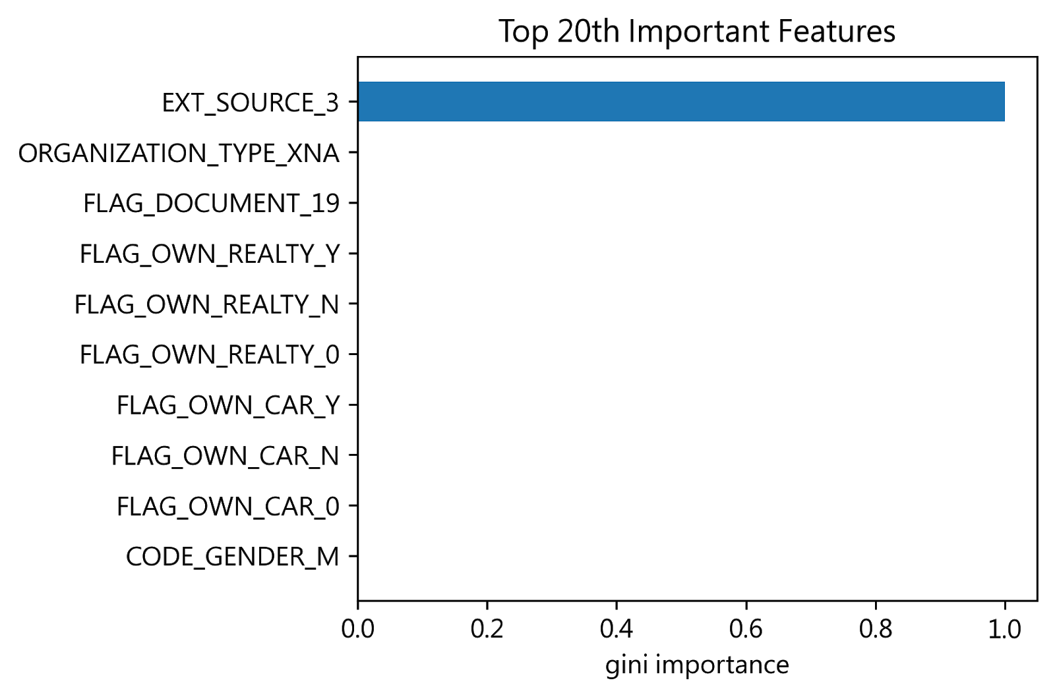
Decision Tree --- opt_score1
Feature Importance

Slide 46
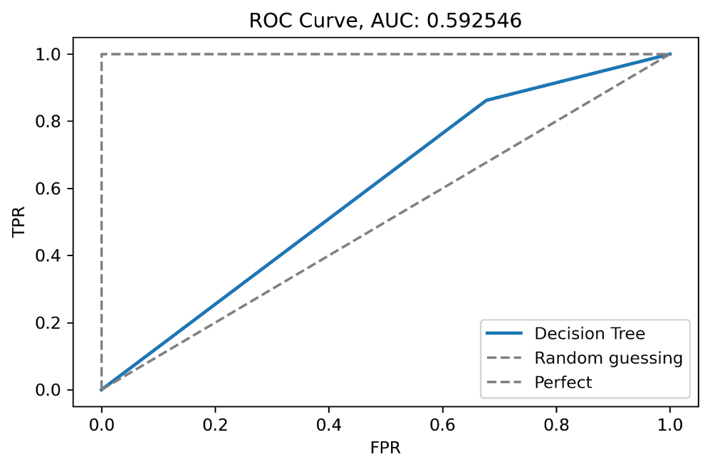
Decision Tree --- opt_score1
Confusion Matrix
ROC Curve

Slide 47
Decision Tree --- opt_score2
Feature Importance

Slide 48
Decision Tree --- opt_score2
Confusion Matrix
ROC Curve

Slide 49
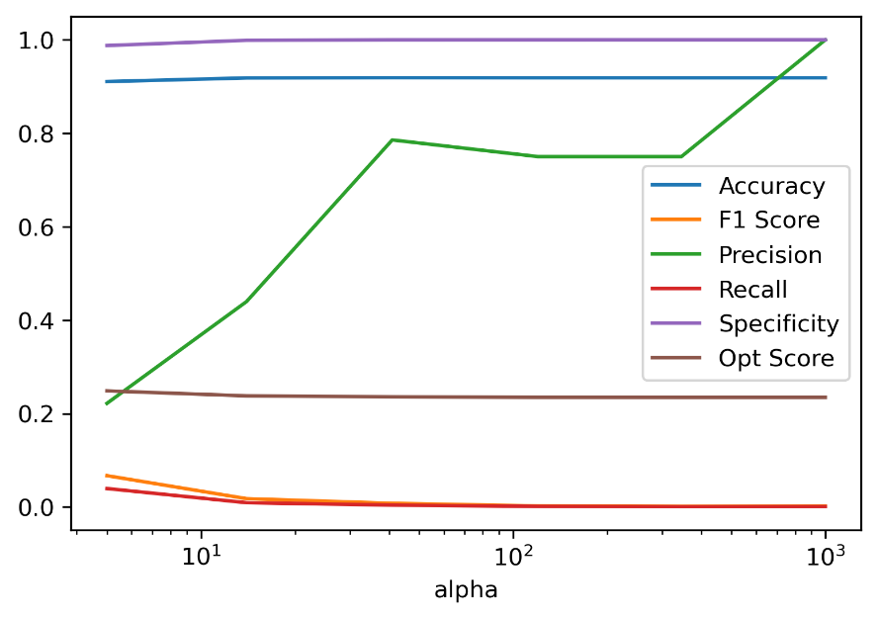
Random Forest
opt_score1
opt_score2

Slide 50

Random Forest --- opt_score1
Feature Importance

Slide 51

Random Forest --- opt_score1
Confusion Matrix
ROC Curve

Slide 52
Random Forest --- opt_score2 ???
Feature Importance

Slide 53
Random Forest --- opt_score2 ???
Confusion Matrix
ROC Curve

Slide 54
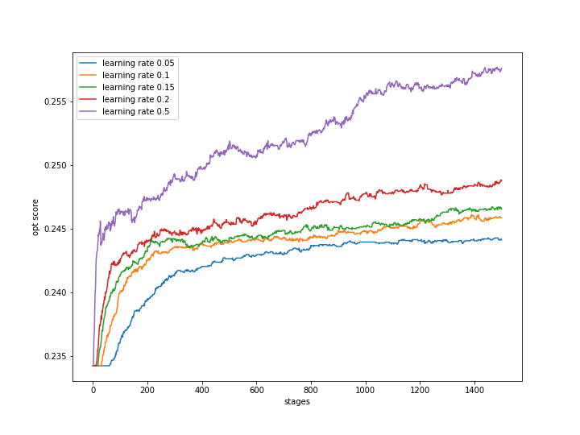
Gradient Boosting
opt_score1

Slide 55
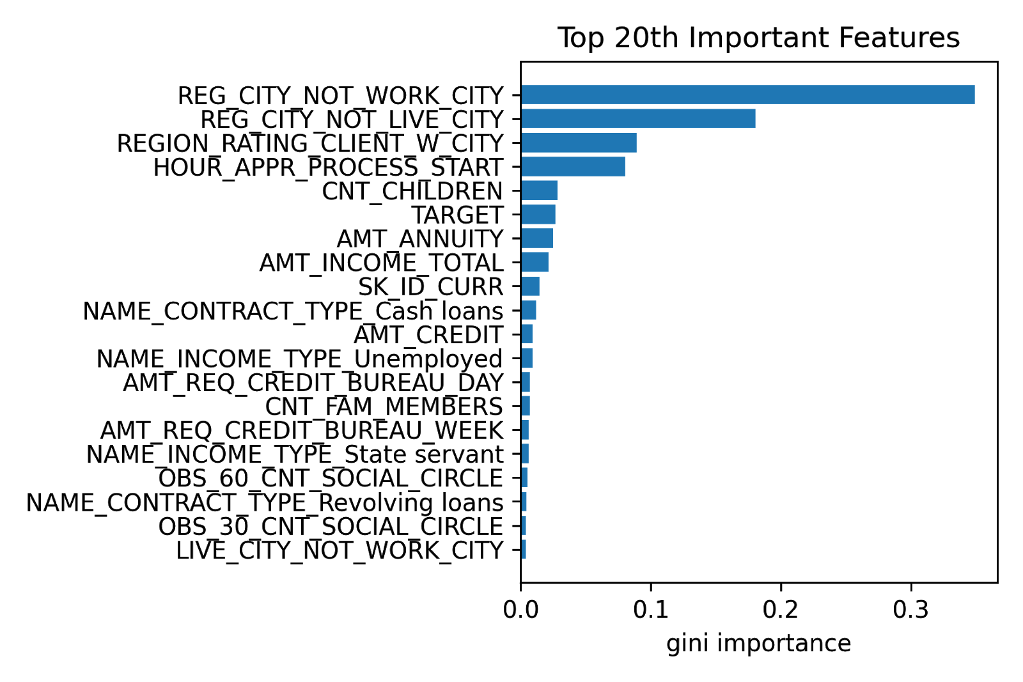
Gradient Boosting --- opt_score1
Feature Importance

Slide 56
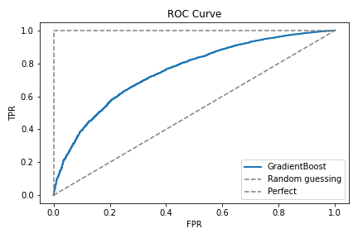
Gradient Boosting --- opt_score1
Confusion Matrix
ROC Curve

Slide 57

XGBoost --- opt_score1
Feature Importance

Slide 58

XGBoost --- opt_score1
Confusion Matrix
ROC Curve

Slide 59
XGBoost --- opt_score2
Feature Importance

Slide 60
XGBoost --- opt_score2
Confusion Matrix
ROC Curve

Slide 61

LightGBM --- opt_score1
Feature Importance

Slide 62

LightGBM --- opt_score1
Confusion Matrix
ROC Curve

Slide 63
LightGBM --- opt_score2
Feature Importance

Slide 64
LightGBM --- opt_score2
Confusion Matrix
ROC Curve

Slide 65
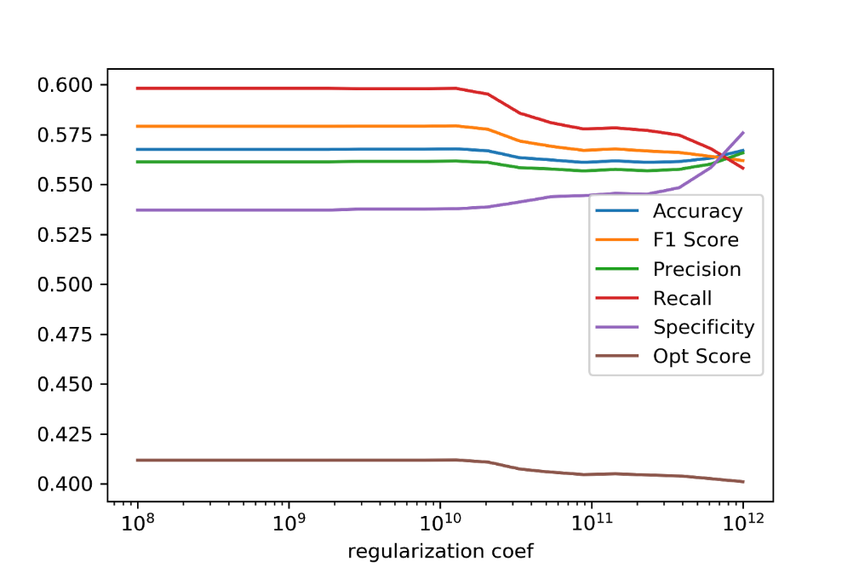
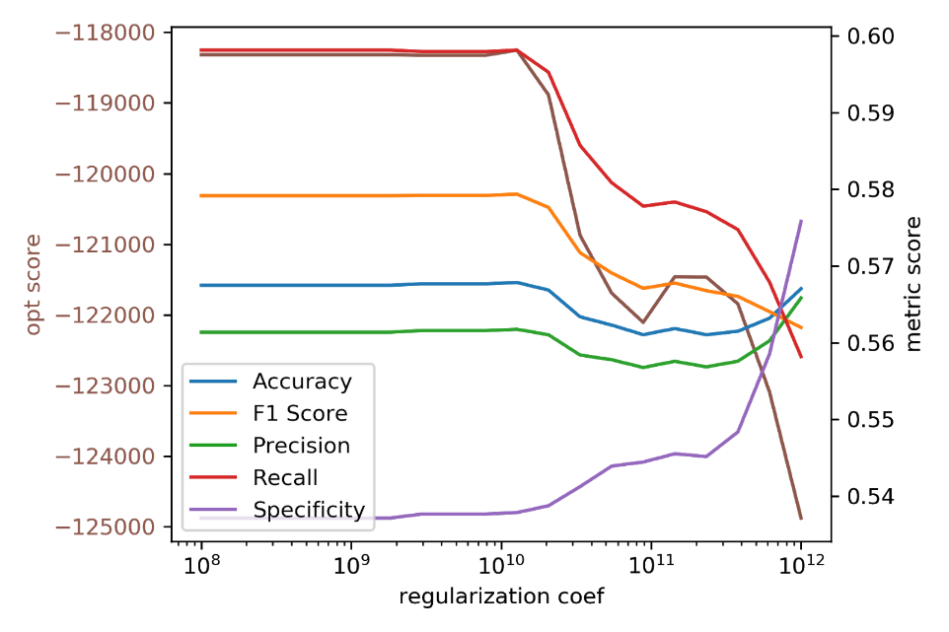
Logistic Regression
opt_score1
opt_score2

Slide 66

Logistic Regression --- opt_score1
Feature Importance

Slide 67
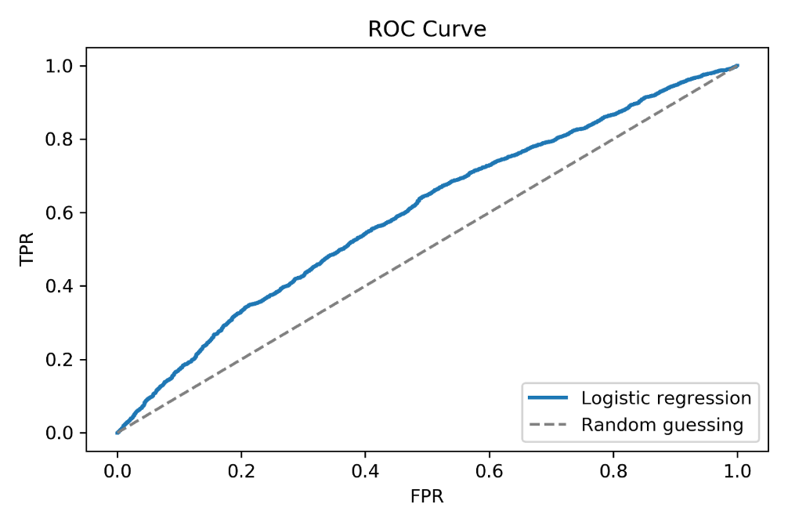
Logistic Regression --- opt_score1
Confusion Matrix
ROC Curve

Slide 68
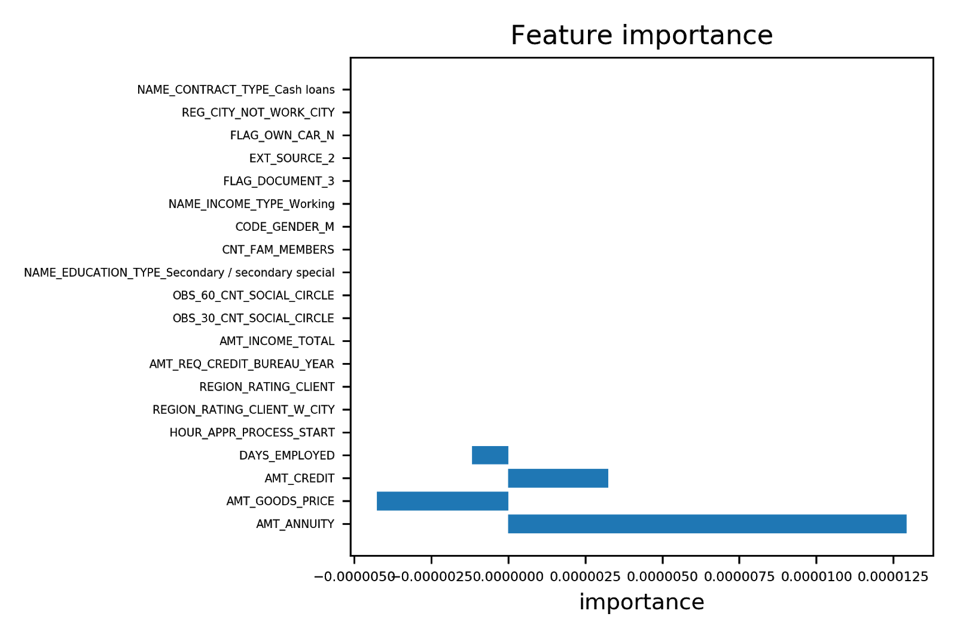
Logistic Regression --- opt_score2
Feature Importance

Slide 69
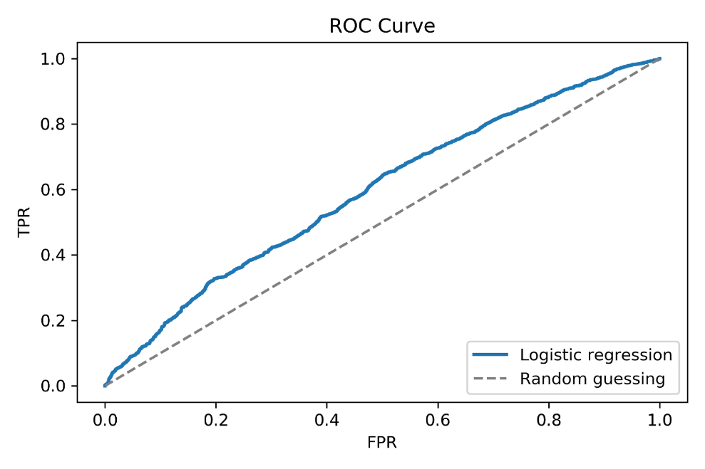
Logistic Regression --- opt_score2
Confusion Matrix
ROC Curve

Slide 70
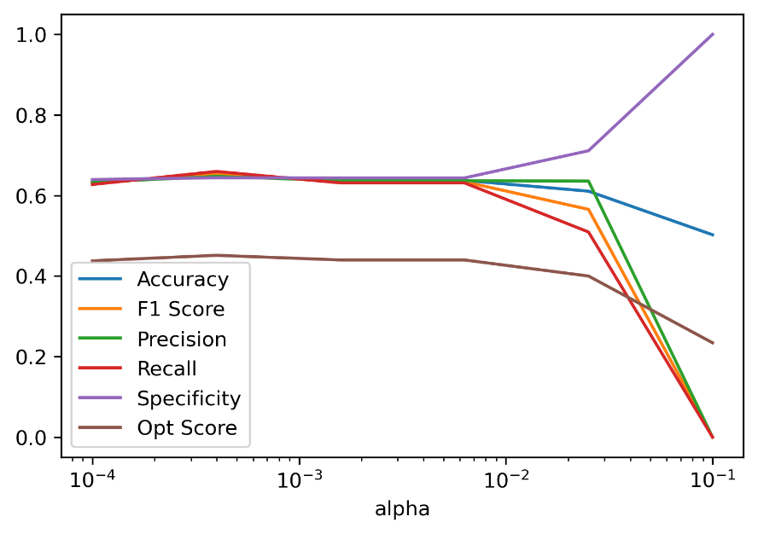
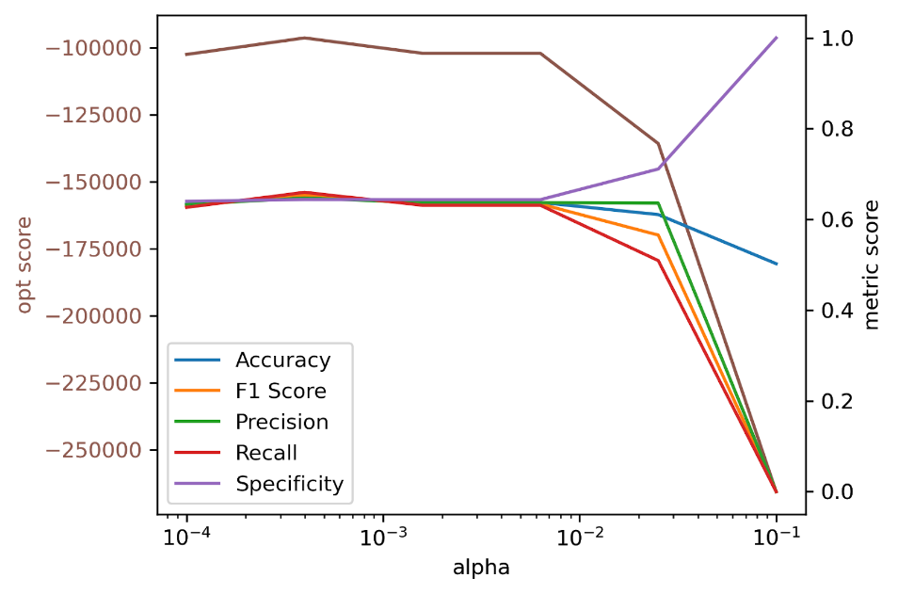
Decision Tree
opt_score1
opt_score2

Slide 71

Decision Tree --- opt_score1
Feature Importance

Slide 72

Decision Tree --- opt_score1
Confusion Matrix
ROC Curve

Slide 73
Decision Tree --- opt_score2
Feature Importance

Slide 74

Decision Tree --- opt_score2
Confusion Matrix
ROC Curve

Slide 75

Gradient Boosting
opt_score1

Slide 76

Gradient Boosting --- opt_score1
Feature Importance

Slide 77


Gradient Boosting --- opt_score1
Confusion Matrix
ROC Curve

Slide 78


Logistic Regression
opt_score1
opt_score2

Slide 79

Logistic Regression --- opt_score1
Feature Importance

Slide 80

Logistic Regression --- opt_score1
Confusion Matrix
ROC Curve

Slide 81

Logistic Regression --- opt_score2
Feature Importance

Slide 82


Logistic Regression --- opt_score2
Confusion Matrix
ROC Curve

Slide 83


Decision Tree
opt_score1
opt_score2

Slide 84

Decision Tree --- opt_score1
Feature Importance

Slide 85

Decision Tree --- opt_score1
Confusion Matrix
ROC Curve

Slide 86
Decision Tree --- opt_score2
Feature Importance

Slide 87

Decision Tree --- opt_score2
Confusion Matrix
ROC Curve

Slide 88


Random Forest
opt_score1
opt_score2

Slide 89

Random Forest --- opt_score1
Feature Importance

Slide 90

Random Forest --- opt_score1
Confusion Matrix
ROC Curve

Slide 91
Random Forest --- opt_score2
Feature Importance

Slide 92

Random Forest --- opt_score2
Confusion Matrix
ROC Curve

